Slide 1
Proactive and Automated Material Control
Fraunhofer USA CMA & U of SC
Dr. Abdel Bayoumi, Dr. Adam Porter, and Dr. Amit Sheth

Slide 2
Agenda
Project vision
Project team
Work breakdown, timelines and deliverables
Expected benefits
Budget information
Questions

Slide 3
Current State of Material Planning
BMW works with a highly complex supply chain, comprising thousands of material numbers and hundreds of suppliers
BMW’s material planners must juggle complex KPIs and an ever-shifting procurement landscape to keep the line running at maximum efficiency
BMW would like to reduce downtime due to missing or late parts, optimize its ordering strategy, and shift material planning responsibilities to more critical needs
Our proposed project uses AI and automation to aid BMW material planners and to improve material planning processes and outcomes for BMW

Slide 4
Notes:
You come to us when there is no off-the-shelf solution to your critical business problems

Slide 5
Notes:
BMW works with a highly complex supply chain which includes managing thousands of material numbers and hundreds of suppliers. Currently, material planners must juggle complex KPIs and an ever-shifting procurement landscape. This project aims to aid the material planner, through AI automation, thereby improving processes and outcomes for BMW. The business value of this project corresponds to reduction in downtime due to missing or late parts, optimizing our ordering strategy, and shifting material planning responsibilities to more critical needs.

Slide 7
Project Team Leadership
BMW
Mr. Allen Godsey
Ms. Natalie Morse
Mr. Marcin Ziolkowski
Fraunhofer USA
Dr. Adam Porter
Dr. Marcel Schaefer
U of SC
Dr. Abdel Bayoumi
Dr. Amit Sheth

Slide 8
Work Breakdown – Phase 1: Data Collection and Development
Data collection and analysis – Analyze data and relationships from existing BMW datasets to help guide AI model development
Domain modeling – develop base entity-relationship ER models representing a wide range of data and interrelationships related to BMW parts, suppliers, part orders, and customer demand
Develop 1st version of MPA – identify subset of “easy to plan” parts, automate handling of these parts, suggest actions to take given a part’s status
Evaluate path to full automation of low-risk parts
Notes:
The first goal, creating a material planner AI assistant, will focus on existing data and subsequent actions taken by the planner.
The goal is to automate “easy to plan” parts, to provide additional time for complex issues to the planner. This AI-based system will ingest a wide variety of data related to BMW part parameters, part orders, shipping information, and supplier performance. This information is primarily found in BMW SAP systems and other applications internal to BMW Group. Initially, this AI assistant will be suggesting actions to be taken given a part’s status and performance.

Slide 9
Work Breakdown – Phase 2:Proactive and Automated Reporting Integration
Enhance MPA to forecast part deliveries and optimize part planning parameters
The forecasting models will incorporate environmental data (border crossings, weather forecasts, and other cyclical/seasonal events that impact the supply network), and quality information that is recorded within BMW applications
The AI system will be trained to incorporate predicted part shortages and offer suggestions to remedy expected shortages that the decision maker (material planner) can either confirm or decline.
The AI system will extract interpretability traces from the AI models indicating specific predictor patterns that led to the shortages and will generate human-readable alerts if predicted supply chain risks rise above BMW-specified thresholds.
If patterns (e.g., continuously short parts) are identified, the AI system will recommend long-term adjustments
Notes:
The second goal of this project, forecasting part deliveries and optimizing part planning parameters, will further enhance this AI assistant. The forecasting models will incorporate environmental data (border crossings, weather forecasts, and other cyclical/seasonal events that impact the supply network), and quality information that is recorded within BMW applications. The AI system will be trained to incorporate predicted part shortages and offer suggestions to remedy expected shortages that the decision maker (material planner) can either confirm or decline. The AI system will extract interpretability traces from the AI models indicating specific predictor patterns that led to the shortages and will generate human-readable alerts if predicted supply chain risks rise above BMW-specified thresholds. If patterns (ex, continuously short parts) are identified, the AI system will recommend long-term adjustments

Slide 10
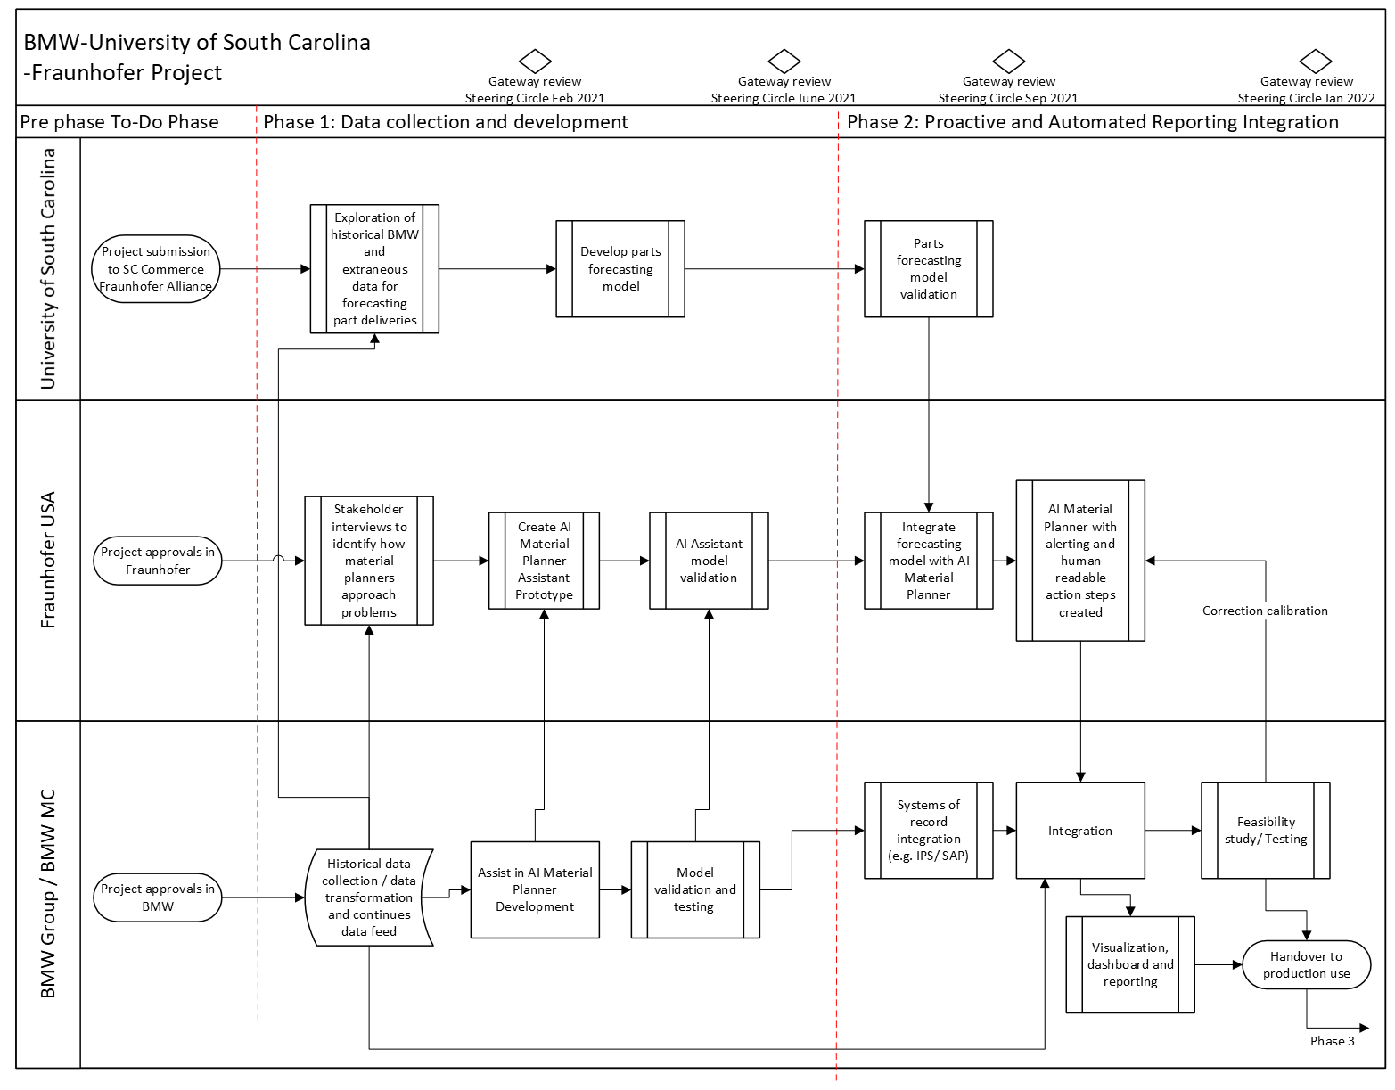
Work Breakdown

Slide 11
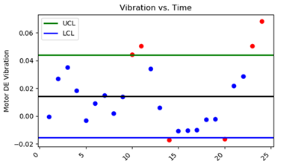
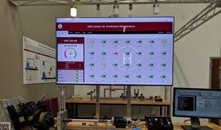
McNair Aerospace Center - Center for Predictive Maintenance
McNair Aerospace Center
Center for Predictive Maintenance
Named in honor of a SC native and Challenger astronaut Ronald E. McNair, the 15,000 sq. ft. McNair Aerospace Center was founded in 2013 to meet the needs of a growing SC aerospace cluster.
The McNair Center’s mission is to grow SC’s knowledge-based economy and support industry through aerospace education, research leadership and industry advancement
Initial research at the Center was in the area of composites
In 2018, the center expanded by another 20,000 sq. ft. to house other aerospace related activates in the College of Engineering and Computing.
Value Engineering Analysis (Cost Benefit Analysis, etc)
Design, Manufacturing, Fault, Usage, and Health Based Algorithms
Sensor Development, Testing, and Diagnostic or Prognostic Algorithms
Analytics
Composites
Drones/Unmanned Vehicles
Dashboards, Augmented and Virtual Reality, Digital Twins
Predictive Maintenance
Combustion
Digital Transformation
Automated Fiber Placement
Digital Transformation and Sustainability
Dashboards
3D Printing (Metal & Composite)
Metal Additive Manufacturing

Slide 12
UofSC Predictive Framework
Analysis
System Processes
Data Collection and Processing
Data Analytics
Decision-making Tools
Process 1
Diagnostic & Prognostic Models
Supervised / Unsupervised Machine Learning
Predictions & Trends
Dashboards
Data Sources
Virtual & Augmented Reality
Data Sources
Process 2
Data Sources
Refinement and Validation
Artificial Intelligence Platform
Process …
Numerics
Refinement of
System
Sensor Data
Supervised / Unsupervised Machine Learning
Calculated Indicators & Scores
Process x
Integrated Database

Slide 13
Proactive and Automated Material Control: UofSC Task Flowchart
Fraunhofer
BMW
Phase 1: Data Collection and Development
Phase 2: Proactive and Automated Reporting Integration
Fraunhofer
Exploration of historical BMW and extraneous data for forecasting part deliveries
Data Formatting and Interrogation
Identifying Relationships in Data
Develop Parts Forecasting Model
Parts Forecasting Model Validation
Data Presentation in Dashboards
UofSC
BMW
TEAM
BMW
Historical data provided by BMW
AI Material Planner

Slide 14
Phase 1 – Data Collection and Development UofSC Task Breakdown
Task 1: Exploration of historical BMW and extraneous data for forecasting part deliveries
Identify rich and poor areas in BMW historical data, and evaluate what compound data inputs are telling us in regard to supply risk. Validate risk levels with BMW personnel
Research and obtain any additional data relevant to risky suppliers
Understand BMWs current production and inventory policies
Extract key figures from historical data for the formulation of the Parts Forecasting Model & part ordering parameters
Task 2: Data formatting and interrogation
Collect data and format in a uniform way. Address problems with the data such as missing data
Task 3: Identifying relationships in data
Use machine learning techniques to discover relationships between datasets
Task 4: Develop parts forecasting model
Part/Supplier risk identification/assessment along with risk mapping/prioritization
Determine optimal order quantities, safety lead-time levels and order time/ordering points

Slide 15
Phase 2 – Proactive and Automated Reporting Integration UofSC Task Breakdown
Task 5: Parts forecasting model validation
Test and validate with historical data
Refine model as needed

Slide 16
Phase 1 FhUSA Task Breakdown
Task 1. Stakeholder interviews to identify how material planners approach problems
Develop, conduct and analyze interviews with BMW staff to address data requirements
Acquire and analyze historical data from BMW
Build prototype ER model of material planning process based on data
Task 2. Create AI Material Planner Assistant Prototype
Design, build and validate AI models focusing on parts that can be handled automatically
Plan system integration with parts forecasting model
Task 3. AI Assistant model validation
Present, review, provide tutorial on AI model, signals and patterns to POC, key stakeholders
Evaluate and improve model performance

Slide 17
Phase 2 FhUSA Task Breakdown
Task 4. Integrate forecasting model with AI Material Planner
Review parts forecasting model requirements and create integration plan
Design unified framework for forecasting model and AI Material Planner
Integrate and test forecasting model with AI Material Planner
Task 5. AI Material Planner with alerting and human readable steps created
Conduct workshops with stakeholders to showcase capabilities, plan alerting functionality and human readable action steps component
Design, implement and test alerting functionality and human readable action steps
Integrate, evaluate new components and test system
Support BMW system integration

Slide 18
Phase 1 BMW Task Breakdown
Task 1. Gather and provide the partners with historical BMW data
Task 2. Assist in AI Material Planner Development
Task 3. Perform model validation and testing

Slide 19
Phase 2 BMW Task Breakdown
Task 4. Systems of record integration
Task 5. Integration of combined parts forecasting model and AI material planner
Task 6. Visualization, dashboard and reporting
Task 7. Feasibility study and testing

Slide 20
Size and Timeline of Economic Impact
50% reduction in production impacts related to material planning error (~$100K savings per year)
30% reduction in special transportation costs related to material planning error (~$45K savings per year)
Anticipate ramping up over a 5-year period, with initial savings of 10% in year 2, reaching 100% of anticipated savings in year 5 (~$500k savings per year)
Benefits expected to continue well after the initial 5-year period

Slide 21
Expected Continuation After Pilot
The goal of this project is to use this MPA and forecasting effort in our daily operations at Plant Spartanburg
We envision expanding this tool to include additional parts that are initially outside the scope of this project
e.g., expand to include Just In Time (JIT) and Just In Sequence (JIS) parts, which have different priorities and processes than our initial efforts focused on bulk parts
BMW envisions generalizing this tool to other manufacturing facilities throughout the global BMW network
IP agreement would allow use of non-BMW system components by other organizations (except certain named direct competitors)

Slide 22
Project Budget and Duration
Duration – 12 months
Total budget – $479,617
Client cash contribution – $239,808.50
Fraunhofer USA allocation – $ 260,000.00
U of SC allocation – $219,617.00
BMW in-kind – Support of multiple BMW engineers

Slide 23
Questions?
Fraunhofer USA CMA & U of SC
Dr. Abdel Bayoumi, Dr. Adam Porter, and Dr. Amit Sheth

